Slide 1


MenstruGreen
By:
Anshika Mittal
Debarpita Dash
Nimmala Rithika Reddy
Pragati Agrawal
Sandela Sai Amruta Varshini

Slide 2
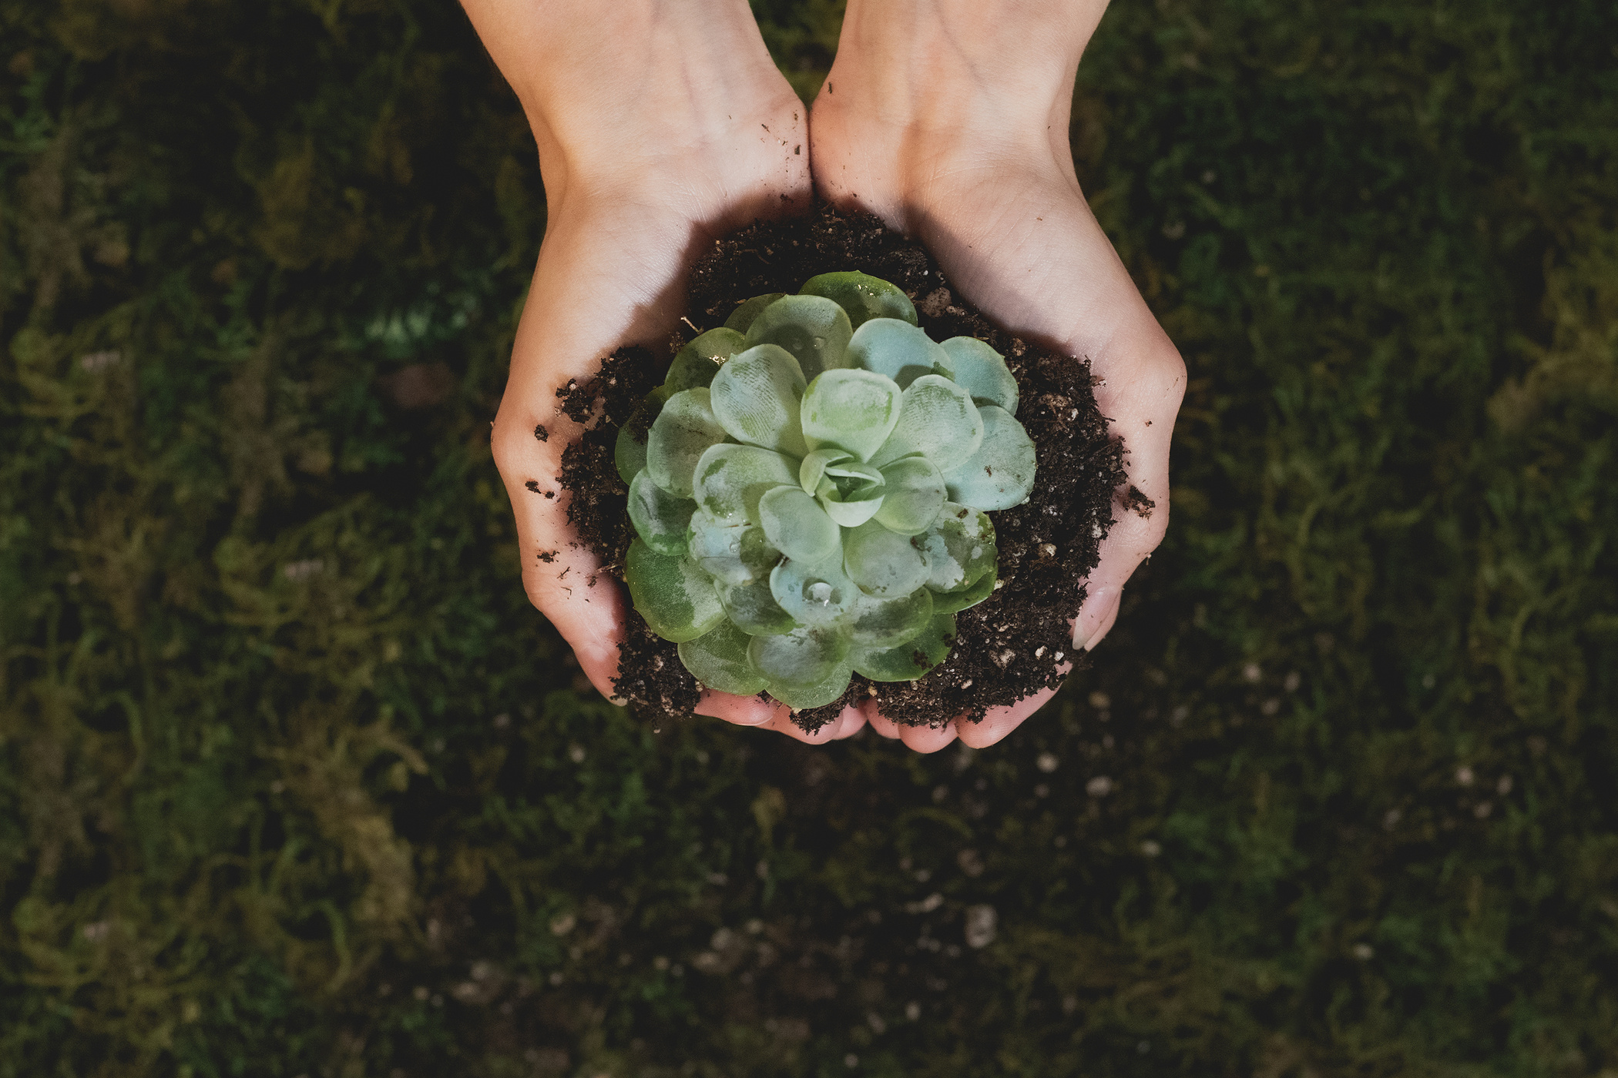
Introduction
Various environment advocacy groups have recognised the problems attached to disposable sanitary napkins and their prolonged use. In the past few years, the country has seen a gradual movement towards switching to sustainable and eco-friendly menstrual hygiene products.

Slide 3


HOW MUCH WASTE DOES INDIA GENERATE?
Around 12.3 billion sanitary napkins, amounting to 113,000 tonnes of waste, reached India’s landfills every year, according to a new study. Improper disposal and non-segregation from household waste leads to unhygienic working condition for waste workers, the report said.
Commonly available sanitary napkins constitute 90 per cent plastic, the report claimed. India generates 3.3 million tonnes of plastic waste every year, according to a Central Pollution Control Board report
A single non-organic sanitary pad contains plastic equivalent to about four plastic bags and takes up to 250-800 years to decompose, the report said.

Slide 4


Contents
03/
Uses of menstual blood
01/
Biodegradable cups
02/
Environment Friendly Packaging

Slide 5
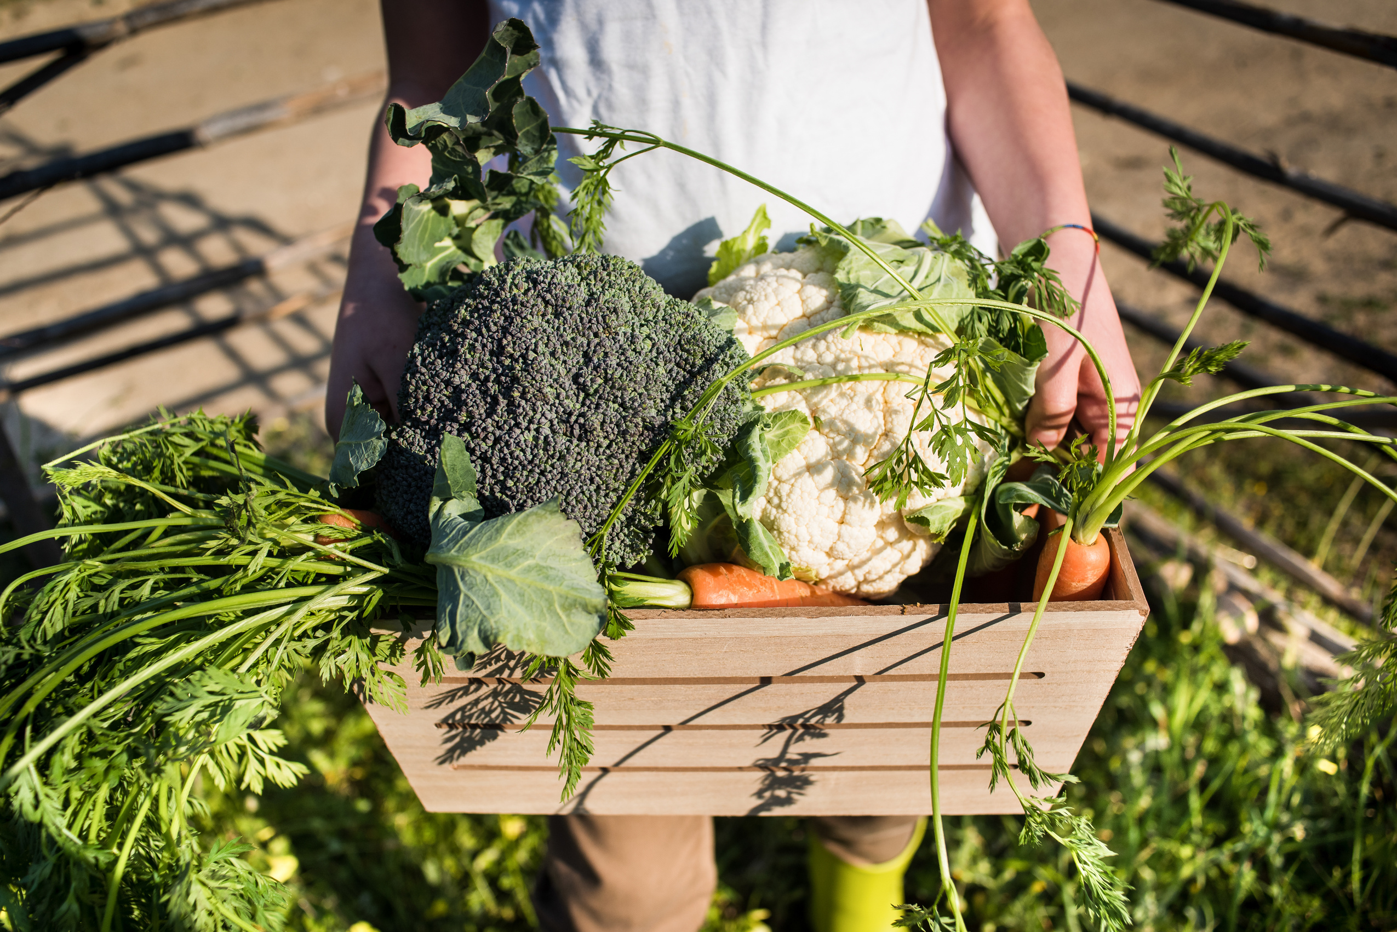
01/
Biodegradable Cups
Menstrual cups are flexible cups made of medical-grade silicone or latex that are inserted into the vagina to collect menstrual blood. They are reusable, eco-friendly, and can last for several years with proper care.

Slide 6
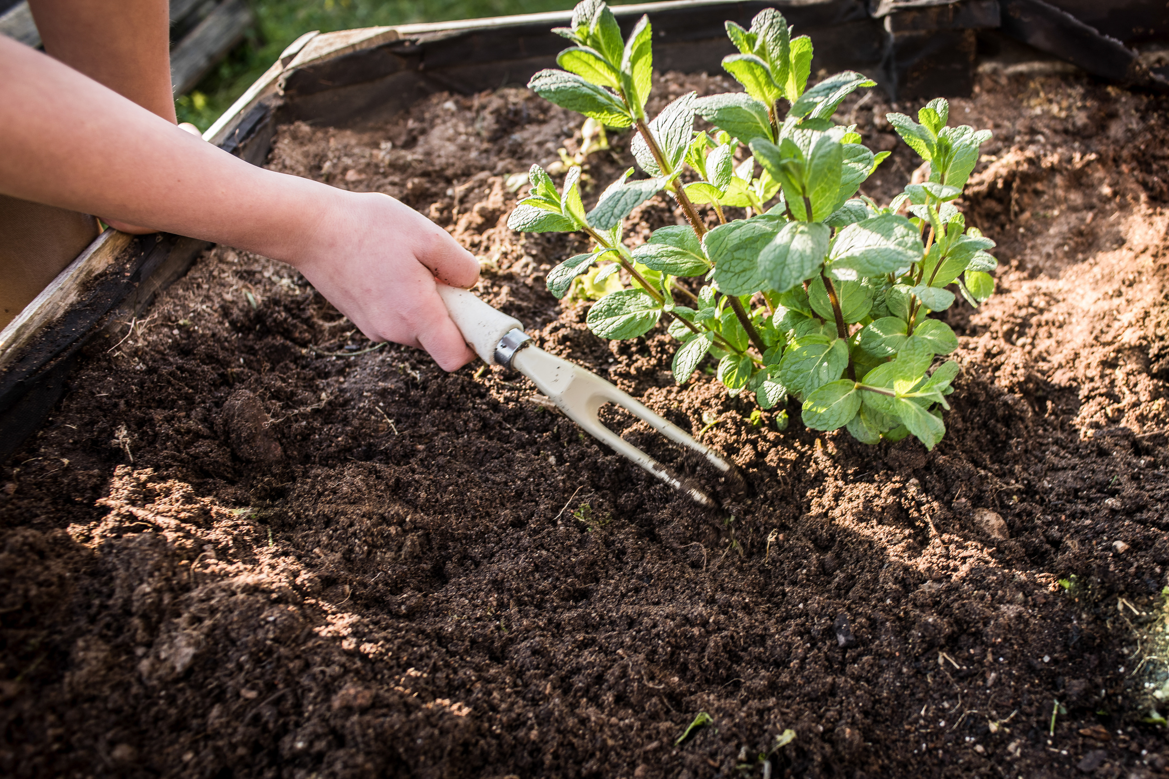
Menstrual cups have been available for decades, but their use remains limited. Despite its safety, eco-friendliness, affordability, and durability, several barriers to adoption persist.After insertion of the menstrual cup, it opens in an oval shape and has to be positioned between the posterior fornix and pubic bone, covering the cervix. To remove it, a finger has to be hooked over the rim behind the pubic bon

Slide 7
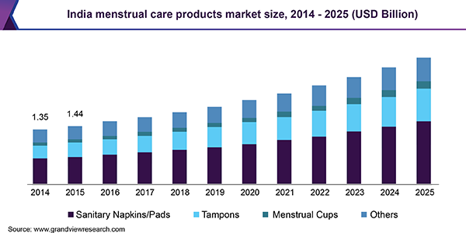

Slide 8
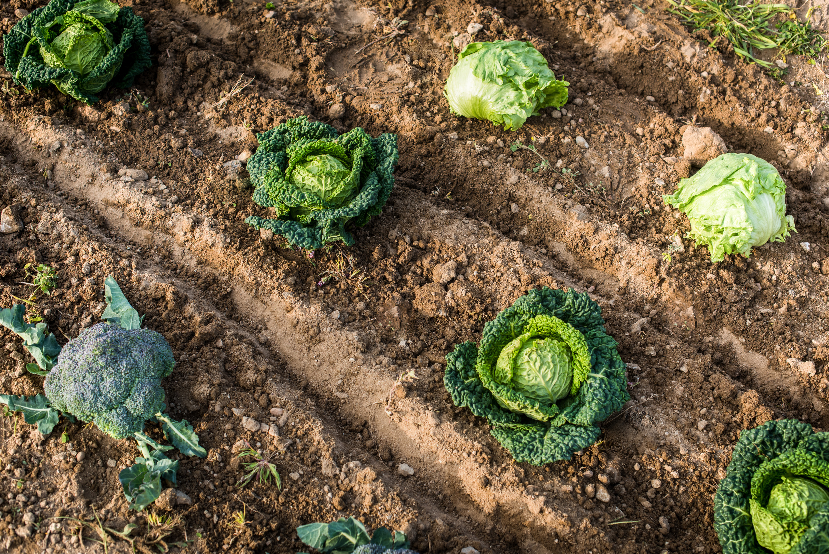
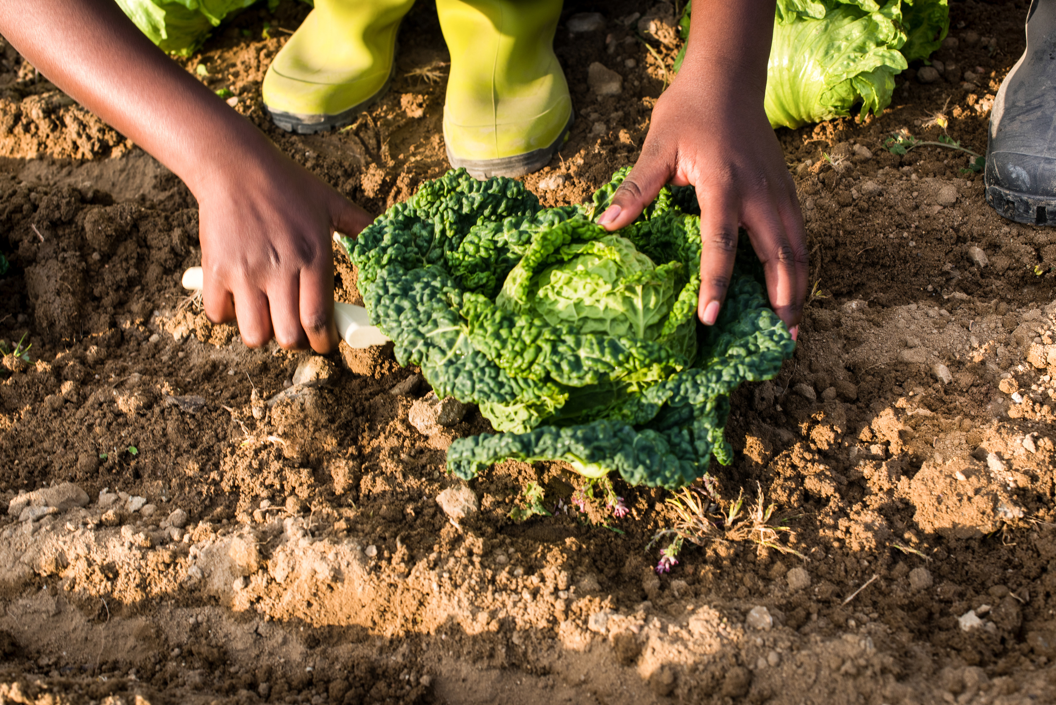
Study shows that menstrual cups are a better alternative to the current methods of menstrual sanitation as it is durable, eco-friendly, comfortable, safe, have no need for frequent changing in a day, and have no disposal issues. According to a study ,adaptability increases gradually through proper counseling, peer support, practice, and consistency. Third time onwards insertion and removal become easier for women. After third cycle, 68% of participants agreed to continue using menstrual cups in our study.

Slide 9
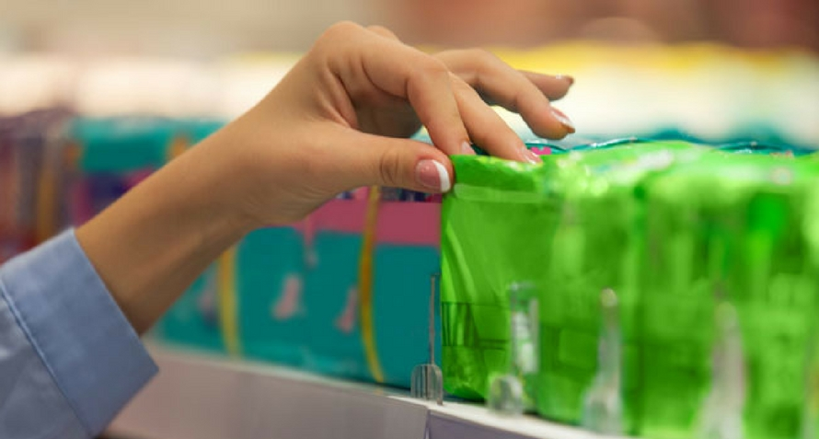
The average woman spends between 4000 to 12000 rupees per year on tampons or pads. On average, a menstrual cup costs between 1700 to 4000 rupees, lasting from six months to 10 years.

Slide 10
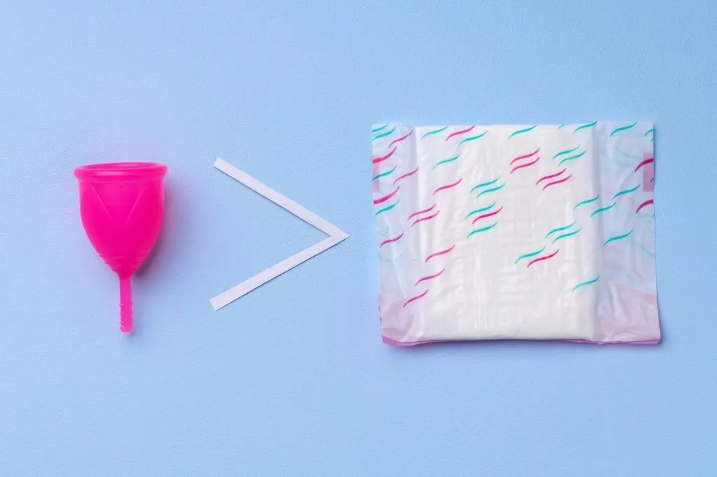
About 14 kg of non-biodegradable waste is generated in a lifetime by a woman if she uses commercially manufactured disposable sanitary pads while the number stands at 0.06 kg for menstrual cups, according to a new report

Slide 11
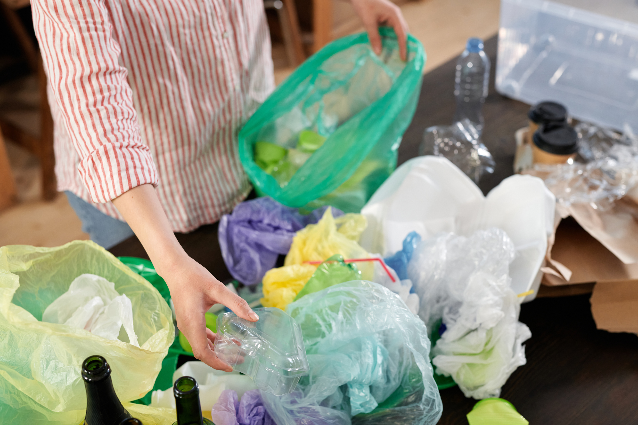
02/
Environment Friendly Packaging
Traditional menstrual products, such as disposable pads and tampons, contribute to vast amounts of non-biodegradable waste that ends up in landfills or, even worse, in water bodies, polluting the environment and posing a threat to ecosystems. Recognizing the urgency of finding sustainable alternatives, the movement for eco-friendly menstrual products has gained momentum. These innovative solutions aim to minimize the environmental impact of menstrual waste by offering reusable, biodegradable, and organic options.

Slide 12


Here are some ideas:
Use of Alginate or Seaweed-Based Materials has moisture-absorbing properties
Plant-based fibers, such as bamboo, hemp, or organic cotton
bio-based polymers derived from renewable sources like cornstarch, sugarcane, or vegetable oils.
Bio-based polymers derived from renewable sources like cornstarch, sugarcane, or vegetable oils
use of natural rubber latex, as it is flexible and durable, as a material for menstrual cups or other menstrual products.

Slide 13
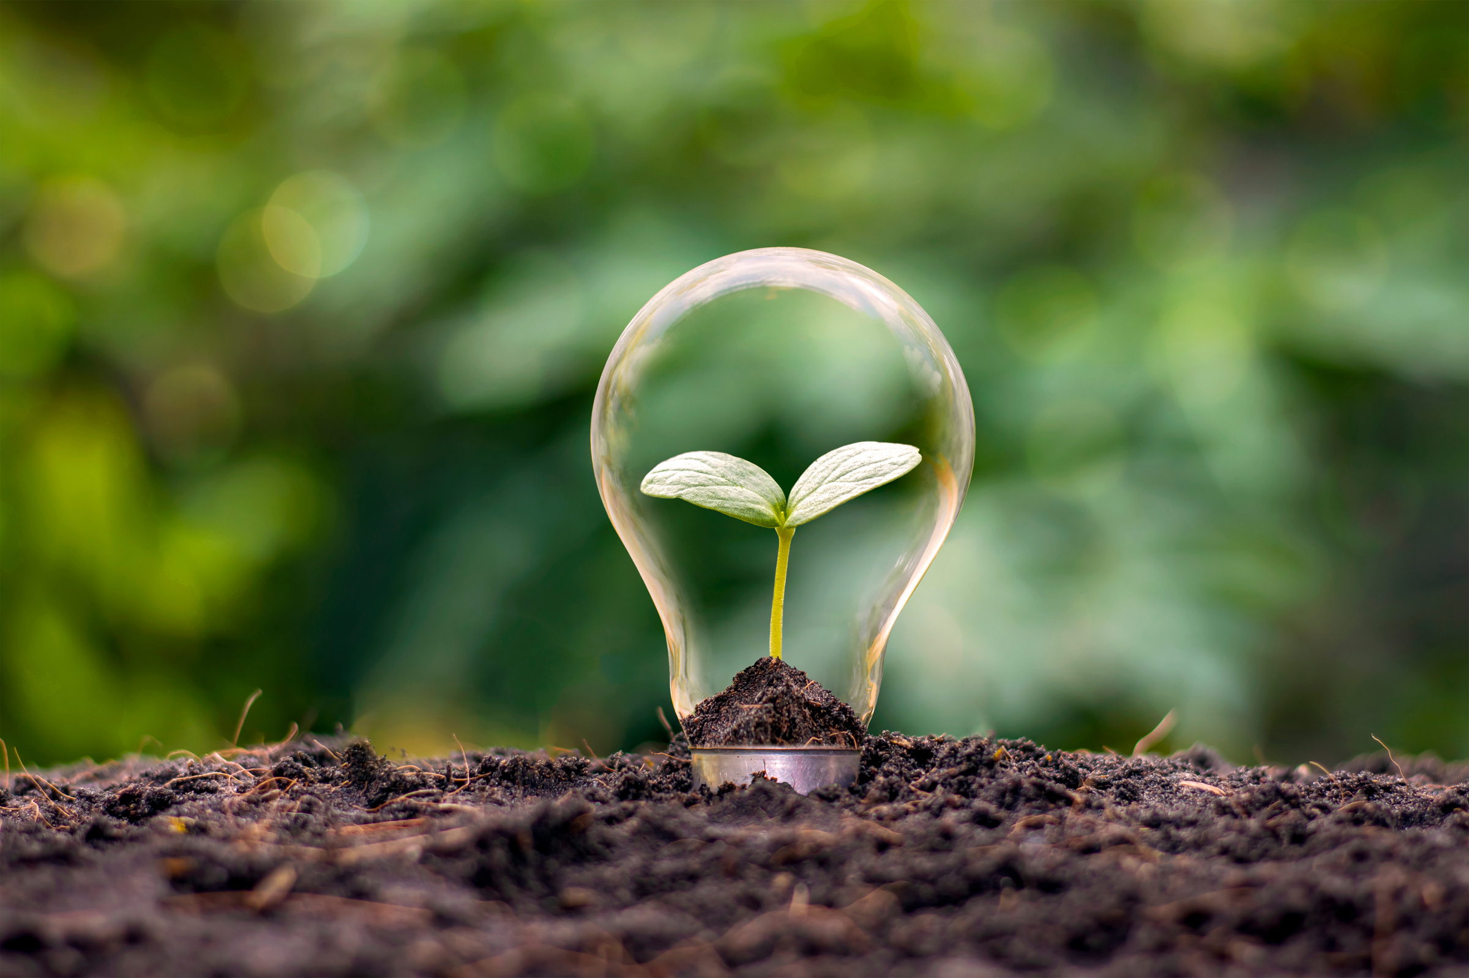
03/
Uses of menstrual blood
Menstrual blood, often considered a taboo subject, is a powerful and natural substance that carries immense potential beyond its traditional association with menstruation.In recent years, there has been a growing interest in exploring the various uses and benefits of menstrual blood beyond its reproductive context.

Slide 14
Menstrual blood is known to be a very good fertilizer since red gold contains electrolytes such as sodium and potassium.
Unlike the blood in our blood vessels, menstrual blood doesn’t clot: it always remains liquid even outside our body.
Menstrual blood contains stem cells similar to those found in bone marrow or umbilical cord blood and has the potential to be used instead for cell therapy.
Stem cells are cells in the body that can change into a huge range of cell types, including bone, muscle, and nerve. This versatility allows tissue to regenerate and overcome disease, and these cells can be transplanted into patients for treatment, such as a bone marrow transplant to treat someone with leukaemia.

Slide 15
A woman will menstruate 400 times in her lifetime, four times. more often than her medieval counterpart. Because life expectancy was shorter, women started menstruating later and they had more children. On average, she will lose 16 litres of blood in her lifetime or the equivalent of eight two-litre soft drink bottles! Menstruation is NOT a waste, but an essential factor in the perpetuation of human life.
This research is focussing on the heart of menstrual blood-derived cell therapy donation: the women donating menstrual blood in the first place. Currently, a common donation procedure is for women to use a menstrual cup. However, only 4% of women currently use one, with most women using a tampon or a sanitary pad. Therefore, research must be done to understand whether a tampon or sanitary pad are effective methods to collect menstrual blood for cell therapy.
This research is the first comparison of menstrual blood donation techniques, comparing tampons, sanitary pads, and menstrual cups. We will see which methods are suitable within the lab, and also suitable for women. Women's age and factors such as history of birth will also be analysed to investigate whether this influences the cells. This work aims to improve women’s health as other benefits arise from the easy collection of menstrual blood samples, as well as to increase and improve accessibility to stem cell therapy globally.

Slide 16

Thank you

